Slide 1

Quote Finder
A tool to search and find quotes based on feelings
CS410
Fall 2023
Manuel Suarez Lunar
Wei-Lun (Will) Tsai

Slide 2

Overview
Project Summary
Architecture
Web Crawler
Preprocessing
Searcher
Web Application and UI
Demo

Slide 3
Project Summary
Project Focus: Development of a unique search engine/text retrieval tool tailored for literature and quote enthusiasts, utilizing Goodreads.com's vast quote repository.
Sentiment-Centric Approach: Unlike traditional search engines, this tool will focus on user sentiments to return a ranked list of quotes that resonate with those feelings.
Code Logic: The project integrates a web crawler for data collection, an indexer for storing the data, a ranker with a sentiment analysis, and web application to interface with the UI
Web Interface Development: Creation of a user-friendly web interface for input submission, enabling access to both quote and author search functionalities.

Slide 4
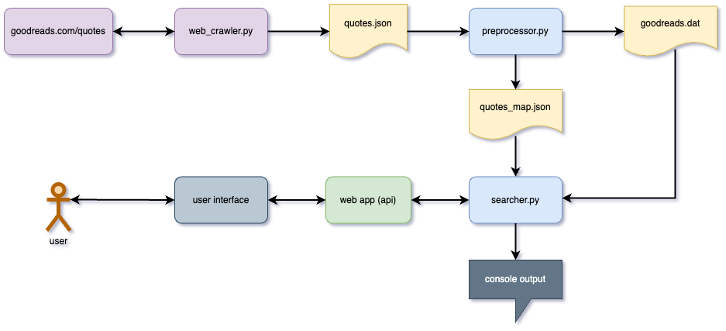
Architecture

Slide 5
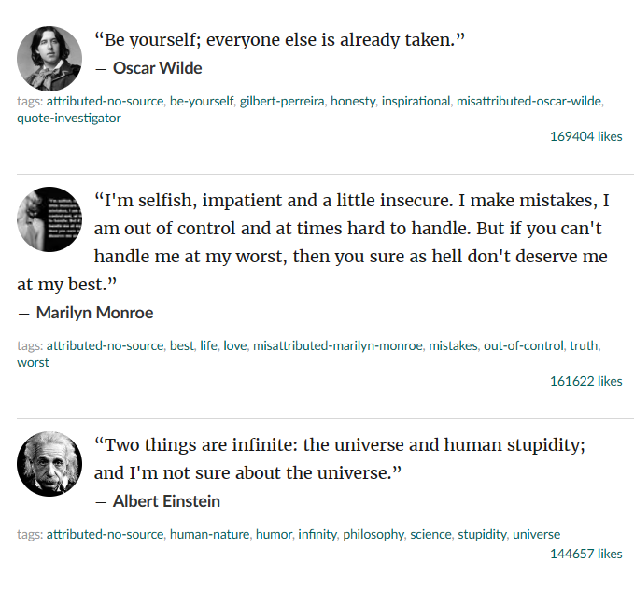
Web Crawler
The web crawler is designed to collect raw text data of famous quotes from Goodreads.com.
It leverages the Python library Scrapy, a popular open-source web scraping tool, to navigate and gather this data efficiently

Slide 6
Preprocessing
Tokenization: leverage Metapy's for tokenization
Parsing and Preparing Data: the script includes a parse_quotes function that processes the JSON file containing quotes and it cleans and organizes the data, preparing it for indexing
Index Preparation: write the processed quotes to a .dat file for indexing purposes

Slide 7
Searcher
Indexing: build an inverted index (build_index)
Ranking: create a ranker (load_ranker) using Metapy's Okapi BM25 algorithm
Sentiment analysis: takes user input to leverages nltk python library (sentiwordnet api) The processes phrases and adjusts queries based on sentiment analysisQuery
Query Processing: load and process user input from web app (load_query), and a function to run these queries against the index (run_query)

Slide 8
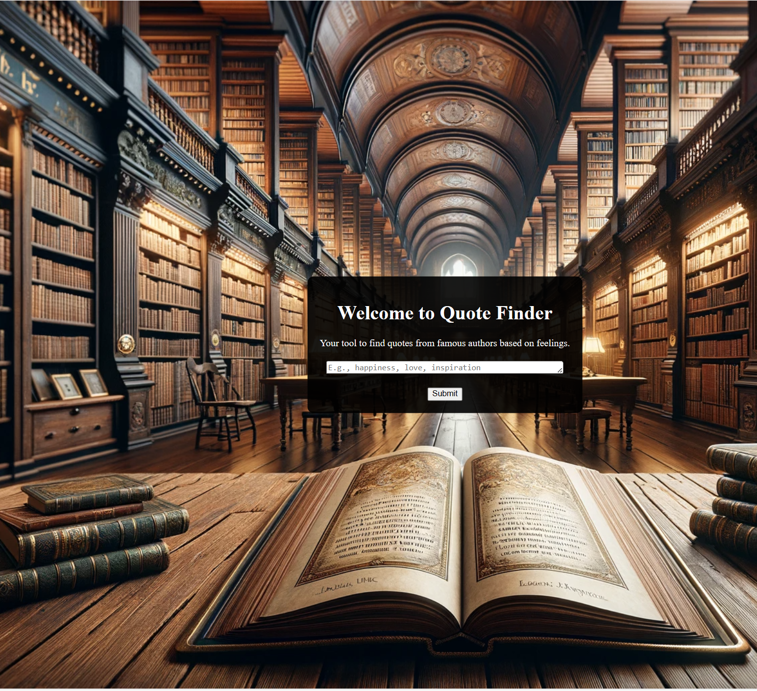
Web App and UI
Web App: utilizes the Flask library to create a web application. Imports and uses the searcher class (from the searcher.py script) for handling the search functionality within the web application.
Index.html: Serves as the main landing page of the web application. Contains a form for users to input their search queries or sentiments, which are processed by the web application
Output.html: Designed to display the results of the user's search query. Shares similar styling with index.html for consistency. Structured to dynamically display search results, including quotes and authors

Slide 9
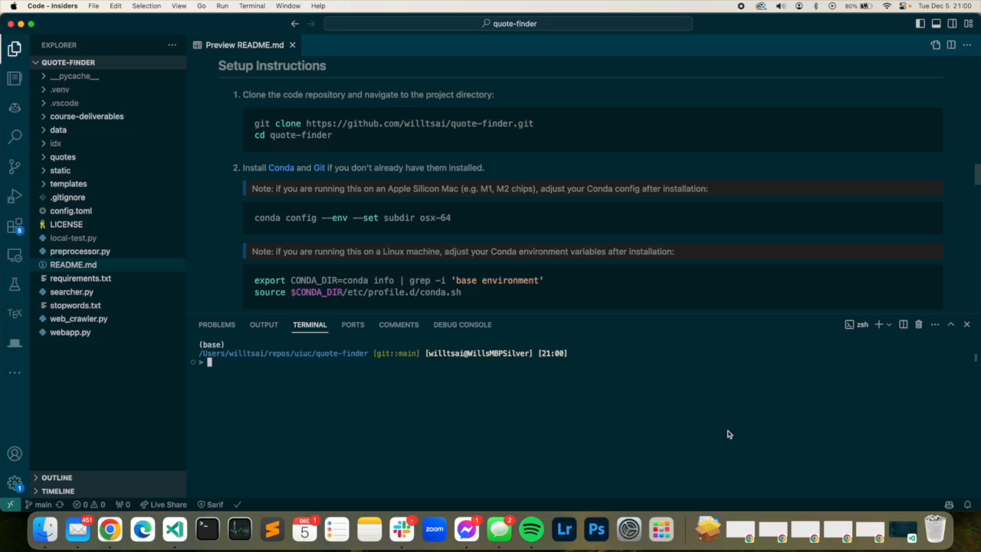
Demo

